Slide 1
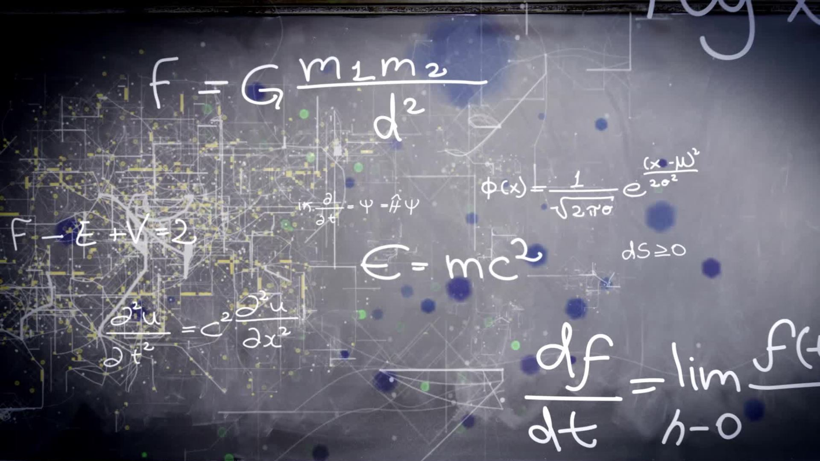
Computer science – A Level (OCR)
40% Grade Computer Systems (2.5 Hours)
40% Algorithms and Data Structures (2.5 Hours)
20% Project​ (6 months on in second year)

Slide 2
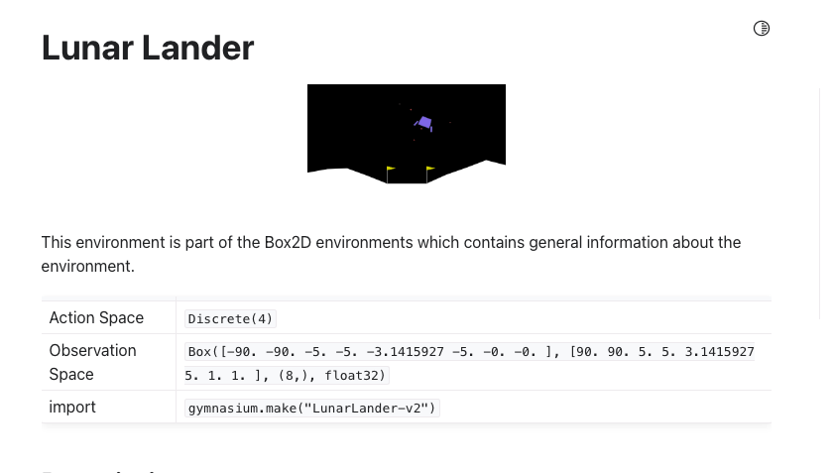
Reinforcement learning task – Will leave training for next 20 minutes....
https://gymnasium.farama.org/environments/box2d/lunar_lander/

Slide 3
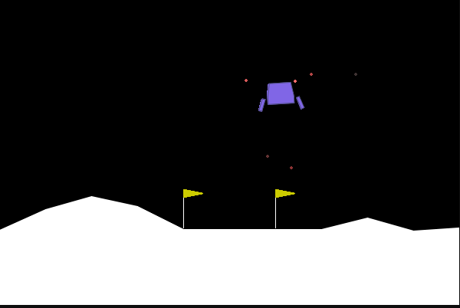
Rewards
Actions
is increased/decreased the closer/further the lander is to the landing pad.
is increased/decreased the slower/faster the lander is moving.
is decreased the more the lander is tilted (angle not horizontal).
is increased by 10 points for each leg that is in contact with the ground.
is decreased by 0.03 points each frame a side engine is firing.
is decreased by 0.3 points each frame the main engine is firing.
0: do nothing
1: fire left orientation engine
2: fire main engine
3: fire right orientation engine

Slide 4
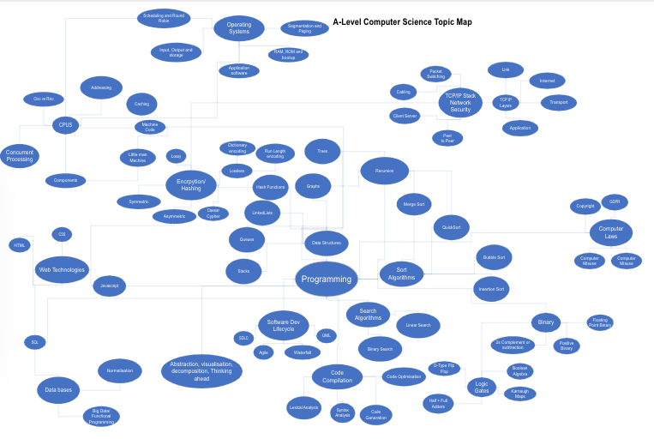
TOPICS
https://cityofbristol-my.sharepoint.com/:u:/r/personal/bsmith_cityofbristol_ac_uk/_layouts/15/Doc.aspx?sourcedoc=%7BD3CEAE4F-74FD-4F02-B810-9803F7ED120B%7D&file=A-Level%20Syllabus%20Topic%20Graph.vsdx&action=default&mobileredirect=true

Slide 5
What will you study in Computer Science?
Programming (variables, if, loops, functions, OOP)
Sorting and searching algorithms and how to code them
Data structures (arrays, stacks, queues, trees, graphs, linked lists)
Shortest Path Algorithms (Djikstra)
How processors work and how to program them
Networking, Operating systems, Scheduling hardware
Databases SQL
Encryption
Binary and floating point
Boolean logic, simplifying circuits
And a project (on any topic you like AI, website, mobile apps or games)
Etc. Etc.
To name just a few things... but mainly coding...

Slide 6
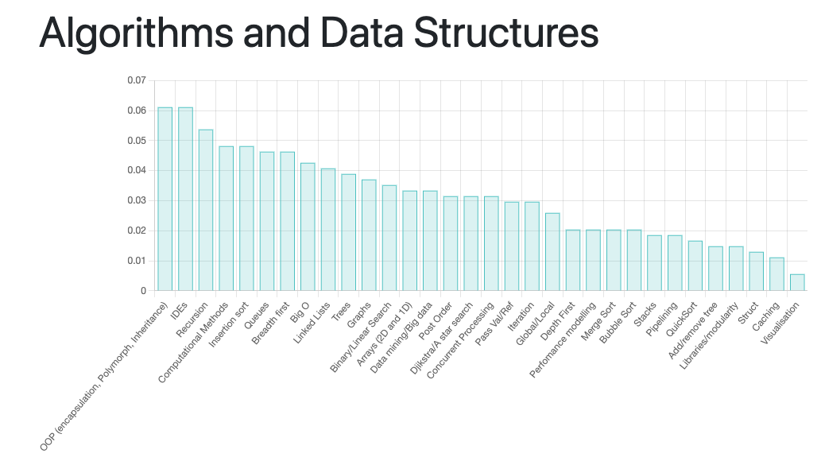
What will you study in Computer Science?
https://alevelcompscimarking.herokuapp.com/

Slide 7
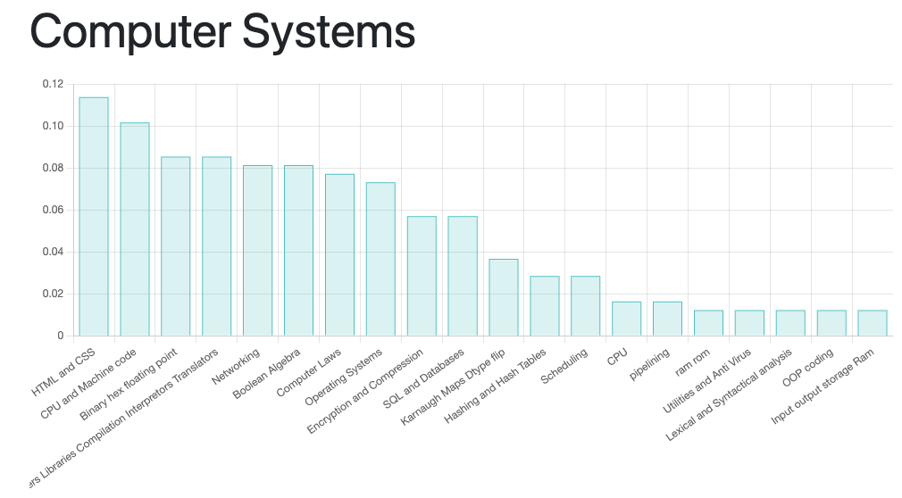
What will you study in Computer Science?
https://alevelcompscimarking.herokuapp.com/

Slide 8

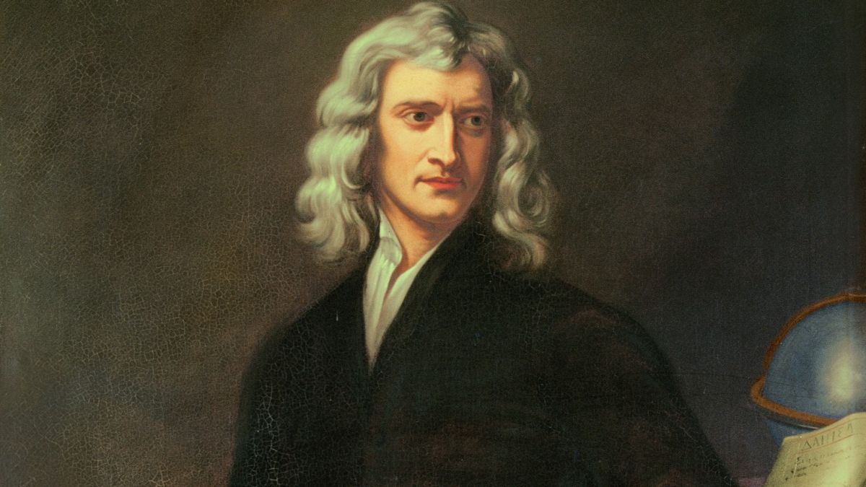
Computing and Maths
How maths relates to other areas of Computer Science
My favourite topics
Chat GPT and AI
Simple Neural networks

Slide 9
Connections of maths and computer science
Discrete Mathematics - Graph Theory: Used in social networks, distributed computing
Linear Algebra – Computer Graphics, machine learning and AI
Probability and Statistics – Data analysis and machine learning/AI
Number Theory – Cryptography, error detection
Combinatorics – How to route data through the internet, networking
Set Theory: Databases. Set theory deals with the study of collections of objects (unions, disjoints etc)

Slide 10
BUT WHAT IS A NEURAL NETWORK?
The job of a NN is to give us outputs based on some inputs.
What we are trying to achieve with it is to reduce the error between the predicted and actual outputs.
First, we pass forward through a network
Then we can back-propagation to adjust the synaptic weights.

Slide 11
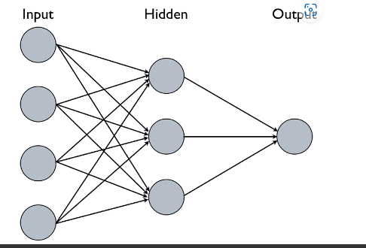
How do you decide whether you go to cinema?
You might give different weights 1- 10 to these inputs...
Weather (5)
Weekend? (5)
Friends available (9)
High movie rating (10)
These either happen or they don’t...
If they reach a threshold of 25 then...
Task:
What is the output if friends are available but nothing else is true?

Slide 12
Forward Pass through NN
Z is the activation
W1 – weight 1 etc (0-10)
X1 – input 1 etc (1 or 0)
Z = w1 * x1 + w2 * x2
If this reaches a threshold of 25 then the activation occurs

Slide 13
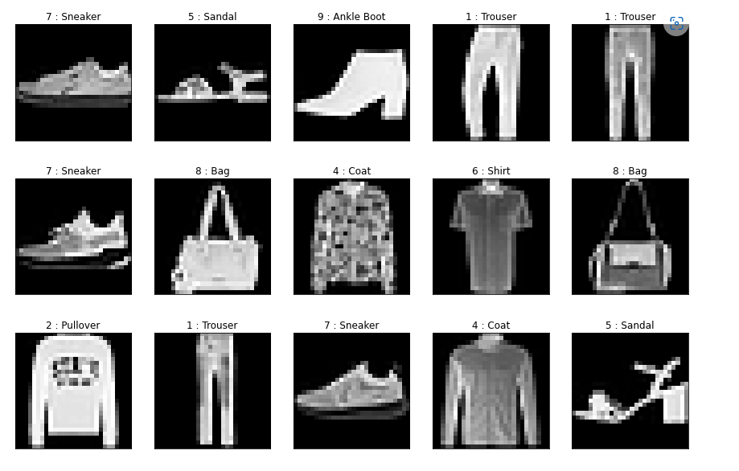
More complex problems such as classifying images
We have a set of images
60,000 are labelled (dress, jumper, shirt etc)
10,000 are unseen used to test the network

Slide 14
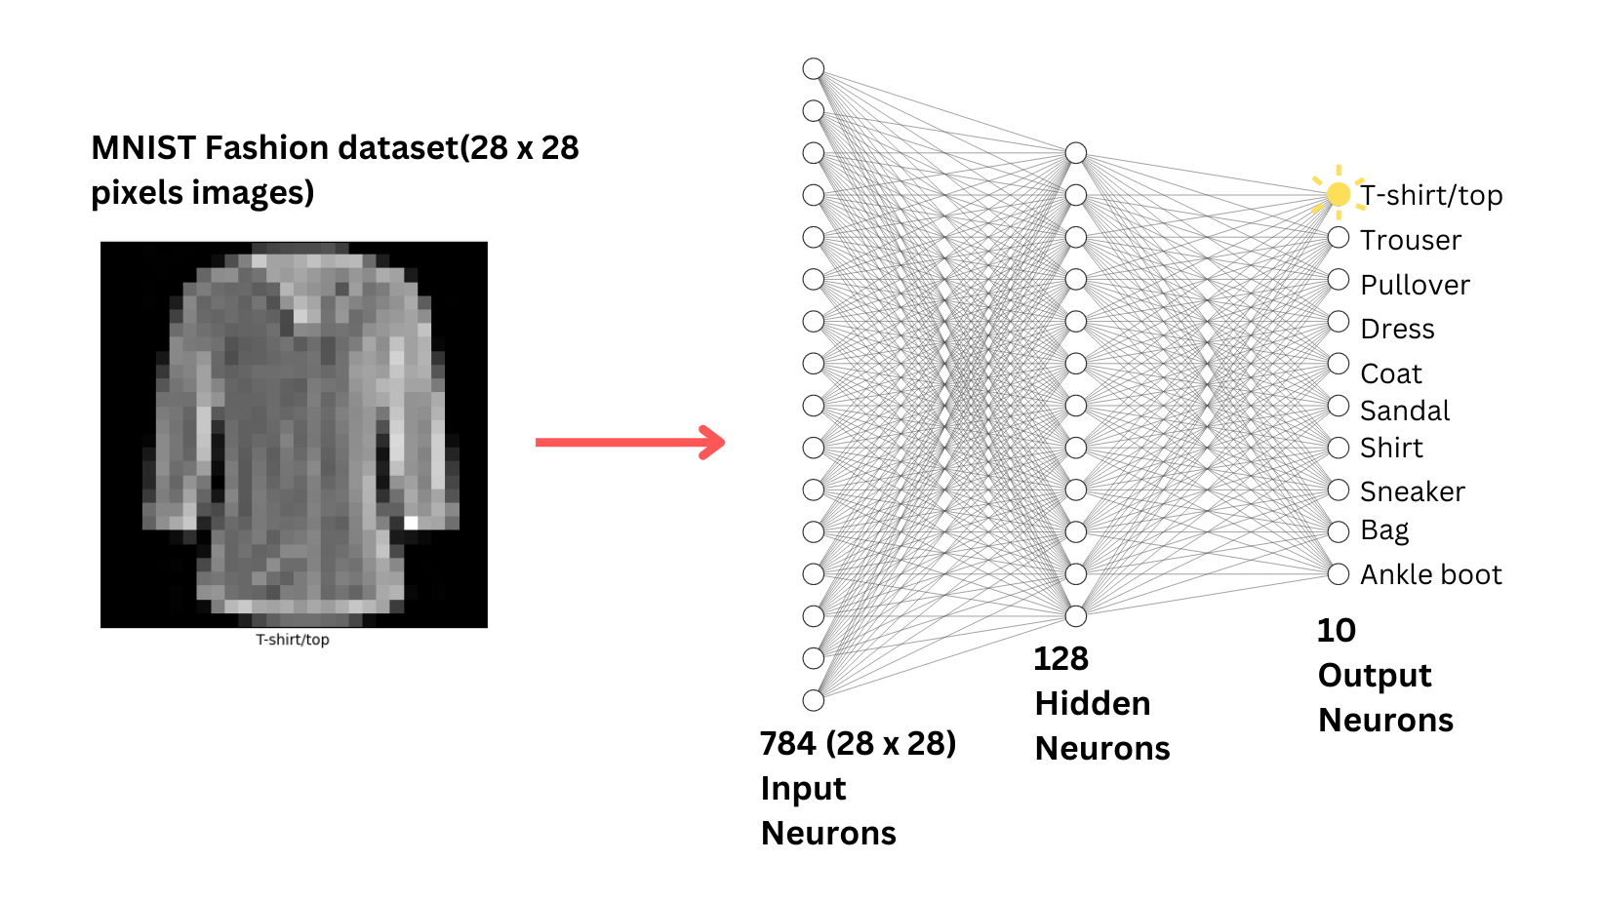
What happens when we train the network?
Looks at the pixels 28x28 (Inputs)
Guesses an image (Output)
Gets it wrong as it compares to the actual output, finds error difference
Then updates inputs weights

Slide 15
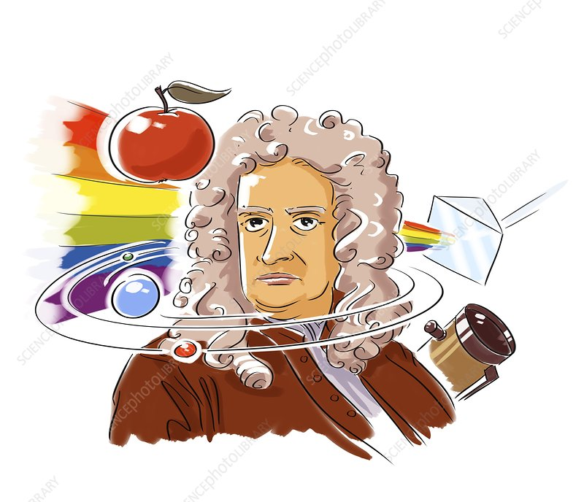
Back-Propagation, Calculus and Neural Nets
To calculate the error difference we use Calculus or the derivative of the error function
We calculate the gradient and update the weights
The errors with highest gradient will contribute more to the error, so we reduce their weight or influence
The opposite happens for those that contribute the least...
How this works in code https://github.com/benSmith1981/classificationAi

Slide 16
Maths and Neural Networks / AI
Uses Gradients
Derivatives / Partial Derivatives
Chain rule
All topics you learn about in Maths Year 2
Based on 400 year old Calculus
AI and Chat GPT was based on ideas by Newton!

Slide 17
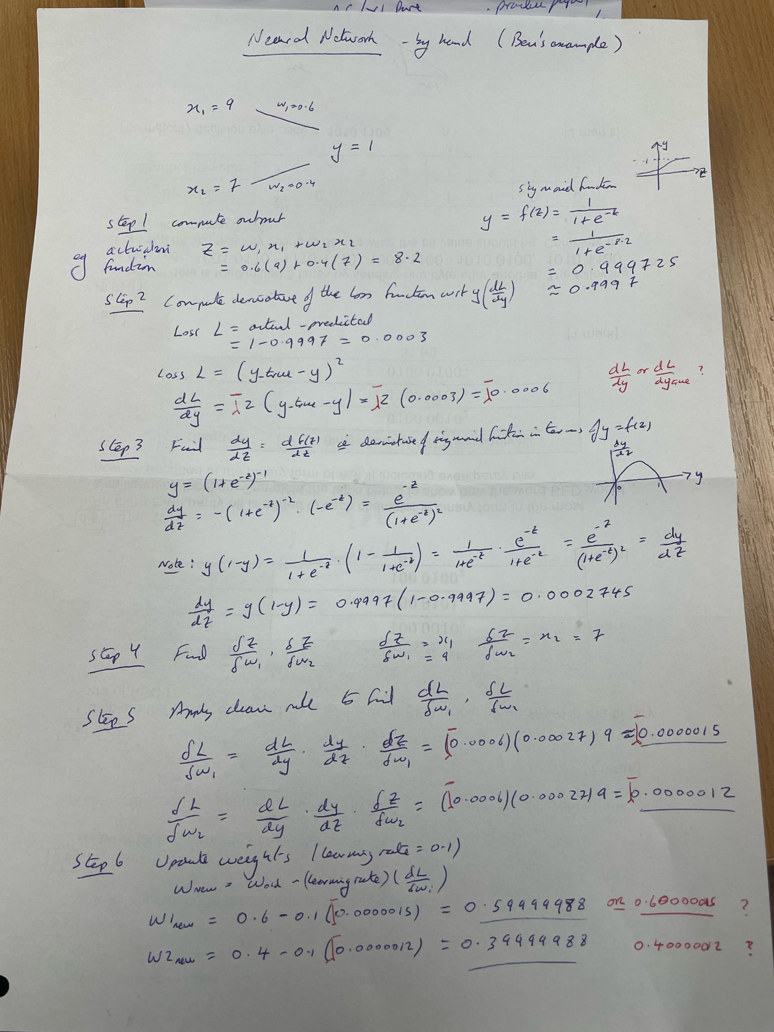
From this one simple idea in maths, gradients calculated using derivatives (calculus) we can train models (Neural Networks) to Perform tasks such as with chat GPT..

Slide 18
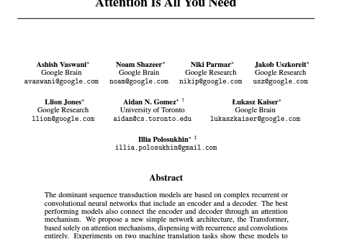


Predicts the most likely words that are next
Encoder (inputs), Decoder (outputs) NN
This uses a transformer architecture
Self - attention to certain words in sentence
Takes advantage of parallel computer power
https://papers.neurips.cc/paper/7181-attention-is-all-you-need.pdf

